Slide 1
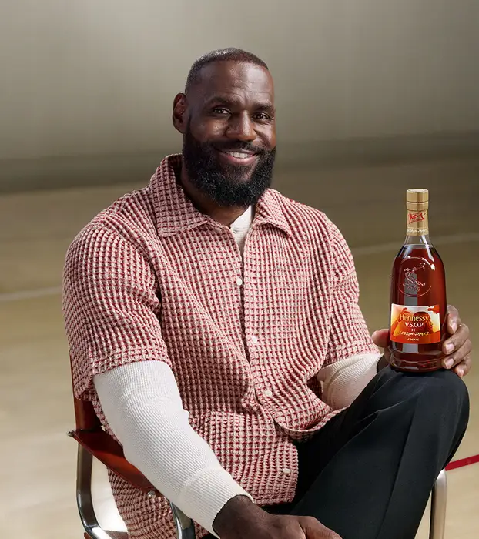
Lebron James x Hennessy Collab
Geovanni Flores
IBM 3072
Current Event

Slide 2
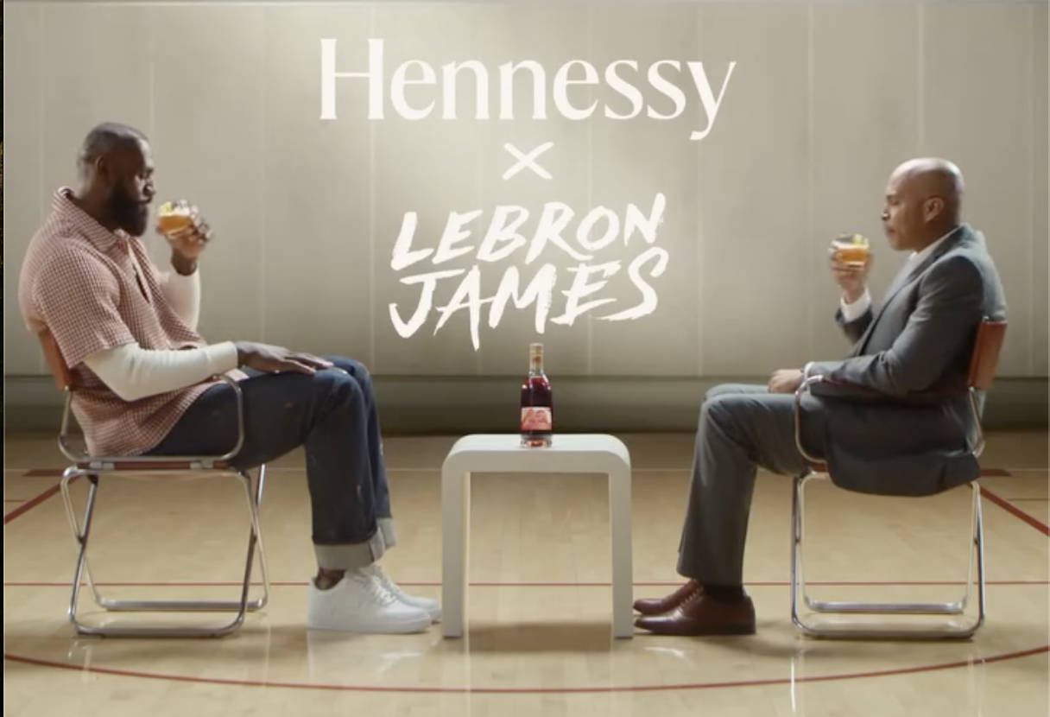
How the collab blew up social media
Lebron James announced on social media his “second decision” wearing the same outfit he did 15 years ago
Announced his decision will be made public the next day
Was trending top 3 on X and one of the most searched on google
Speculation increased Laker home game tickets

Slide 3
Opinion and marketing term
Smart marketing
Brand Equity
Product will probably do well. Collaborations with Lebron James usually sell well (shoes, merch, Etc.)
Article Link: https://abcnews.go.com/GMA/Culture/lebron-james-retirement-decision-announcement/story?id=126267171

